Slide 1
How to place a BT Ipstream Provider Order on Enhanced Eco+
Version 1
Notes:
Security classification options: – Public
– Internal
– Confidential
– Highly Confidential

Slide 2
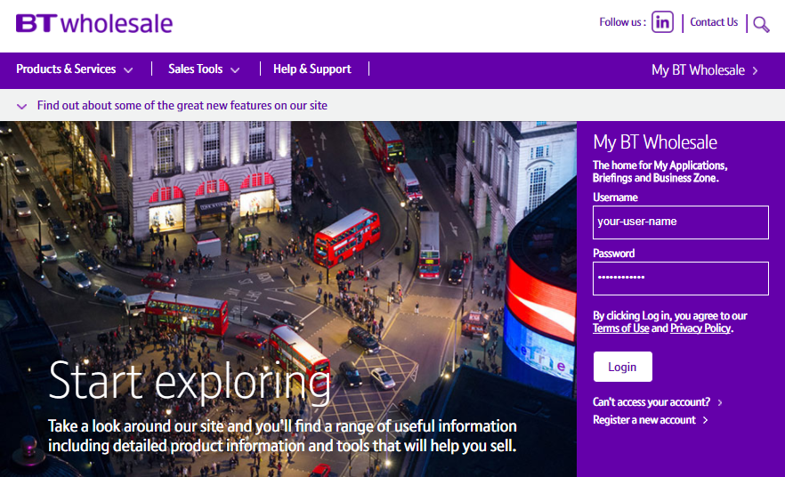
How to place a Ipstream Provide Order on Enhanced Eco+
Step 1: Logging In
Go to www.btwholesale.com
Enter your Username and Password
Click ‘Login’

Slide 3
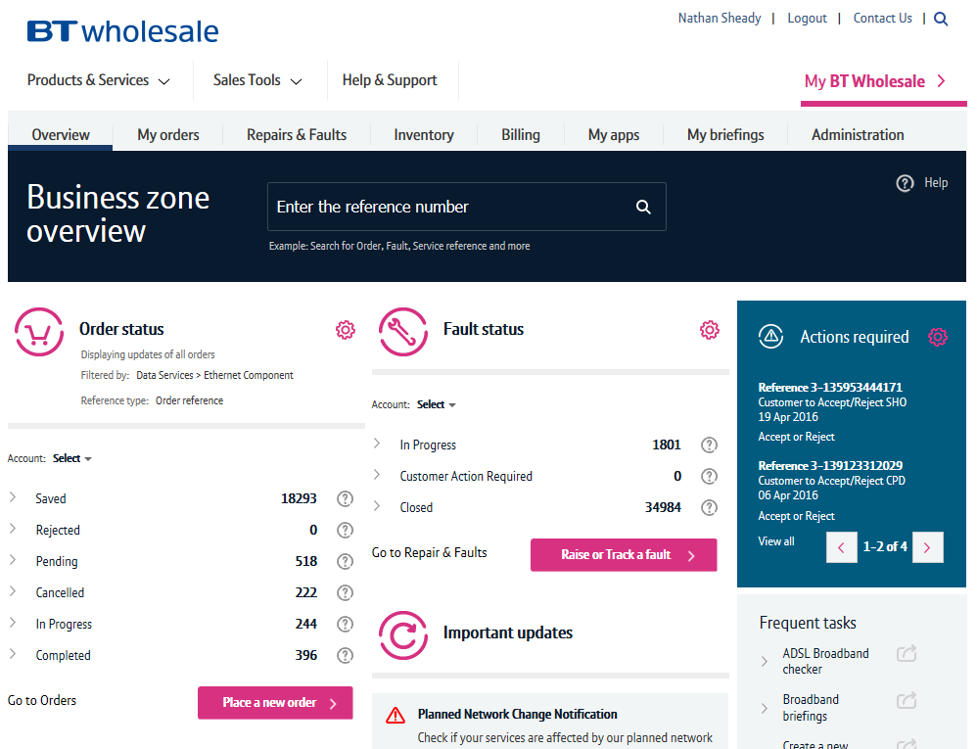
Guidance
This guide takes you through the step-by-step instructions to place a BT Ipstream provide order on the Enhanced Eco+ system.
From 12th July 2020 you will have to use the new system to place all FTTC orders. The old journeys on eCo+ will be disabled on this date.
Please visit our page on BTWholesale.com for a full breakdown of the costs by product.
https://www.btwholesale.com/help-and-support/pricing/service-provider-price-list.html#section44-wholesale-broadband-services
Further information can be found in the relevant
Fibre Broadband - Products & services | BT Wholesale

Slide 4
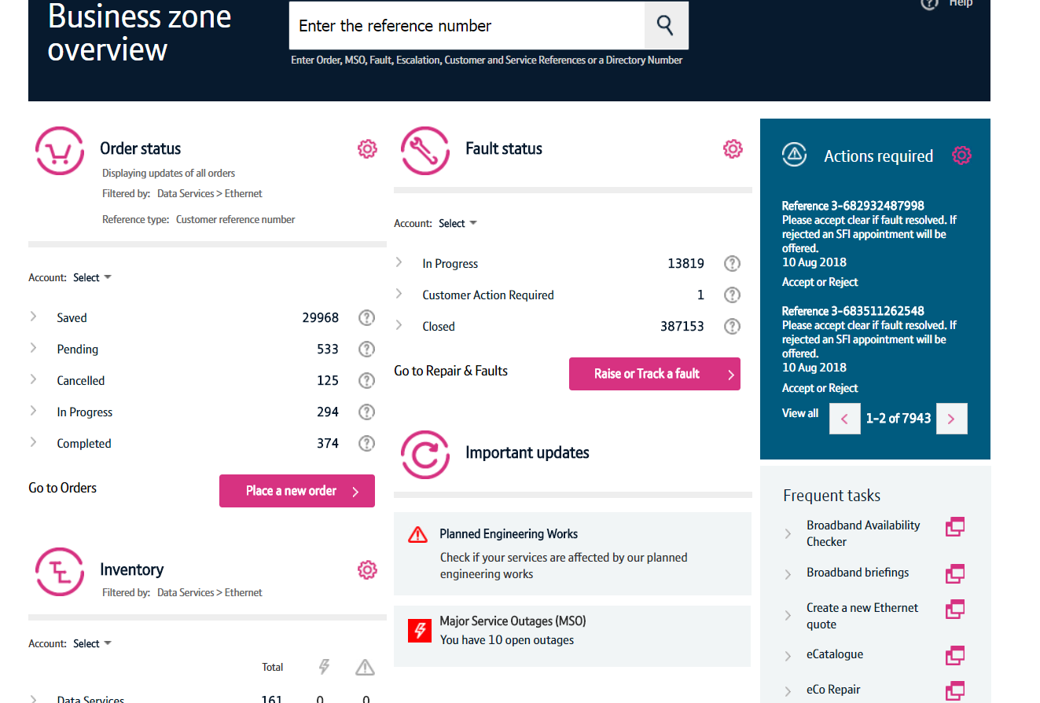
How to place a Ipstream Provide Order on Enhanced Eco+
Step 2: Accessing the journey
Once logged in, you’ll be taken to Business zone.
If you aren’t taken to Business zone, you’ll need to arrange access via your company administrator.
To access the new journey:
1. Click on the place a new order Option.
1

Slide 5

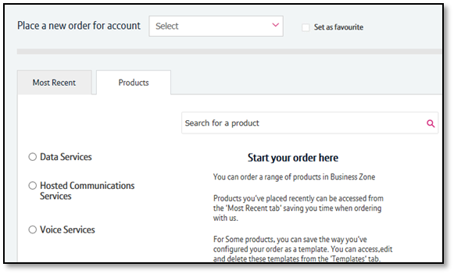
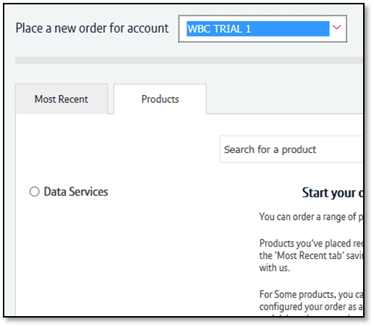

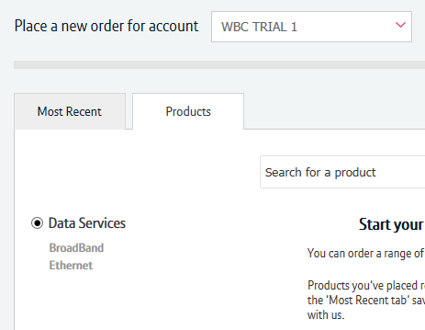
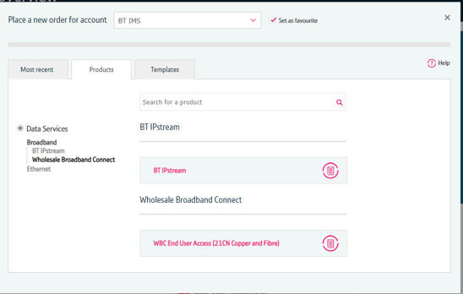
How to place a Ipstream Provide Order on Enhanced Eco+
1
Step 2: Accessing the journey
If you have multiple accounts associated with your user id, you’ll need to select the applicable account from the dropdown.
If you have multiple accounts, select the account from the drop down menu. Tick the ‘Set as favourite’ box if you want this to be your default account
Click ‘Data Services’.
Click ‘Broadband’.
Select ‘Ipstream’.
If you have performed these steps previously then the product will be listed on the ‘Most Recent’ tab
4

Slide 6
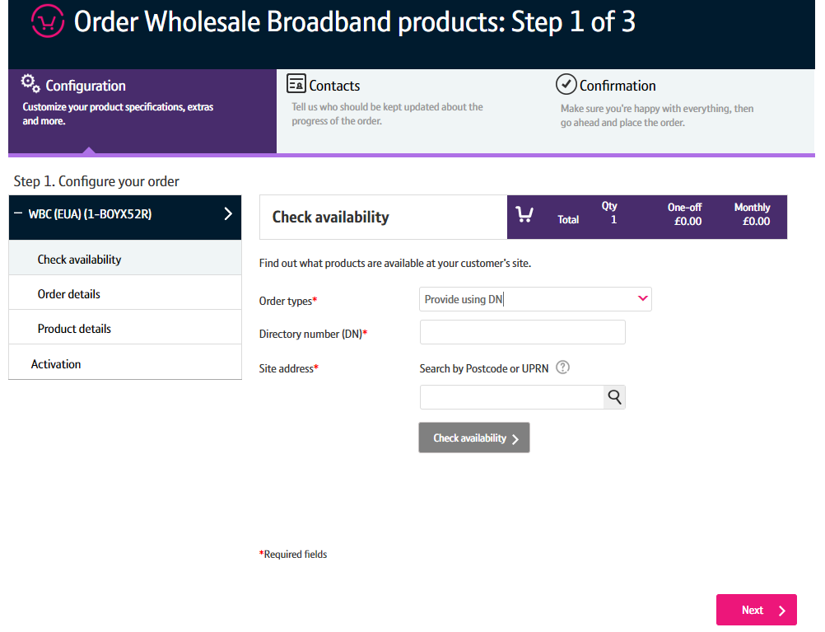
How to place a Ipstream Provide Order on Enhanced Eco+
Step 3: Select the Order Type
1. Select ‘Provide using DN Option
1

Slide 7
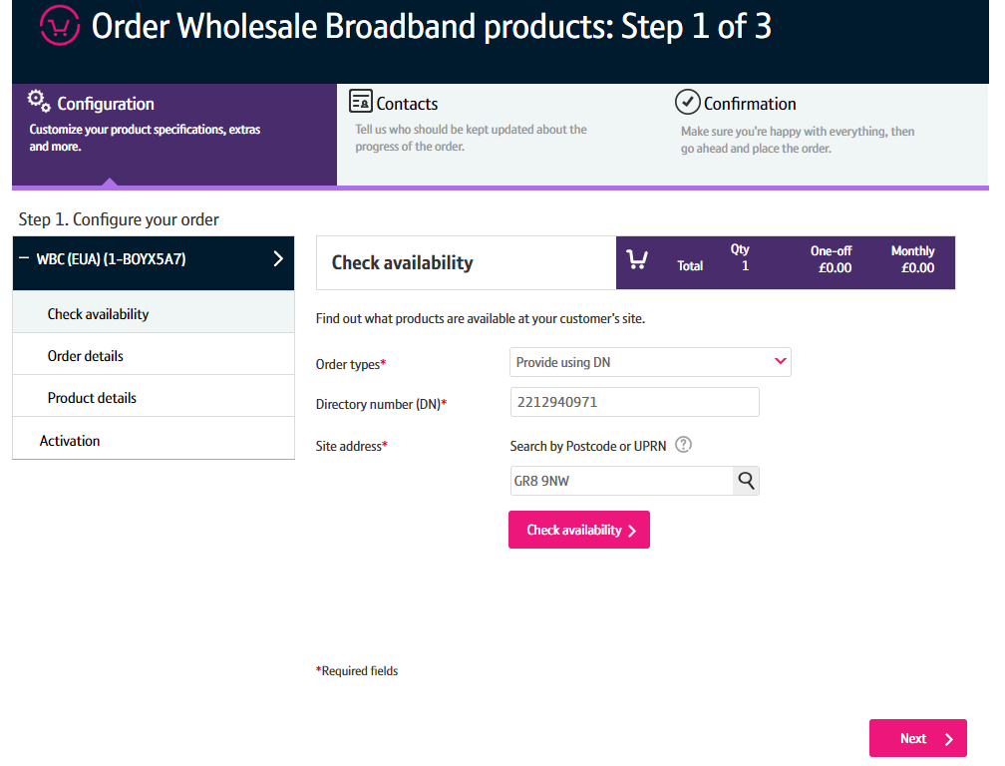
How to place a Ipstream Provide Order on Enhanced Eco+
Check availability page - inputs
Step 4: Select the Address
1. Enter the Postcode.
2. Press the magnifying glass to look up the full address.
You can continue without selecting the full address however we recommend selecting the full address for accuracy on the order.
1

Slide 8
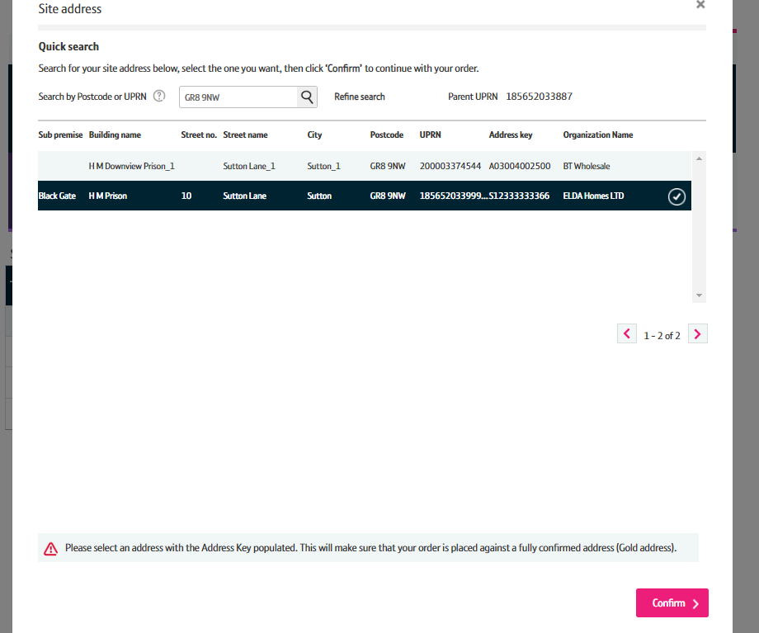
How to place a Ipstream Provide Order on Enhanced Eco+
1
Step 4: Select the Address
1. Select the address from the list
2. Select ‘Confirm’ at the bottom of the page
Note: Use the scroll bar to see all addresses. Only 5 will show in the box.

Slide 9
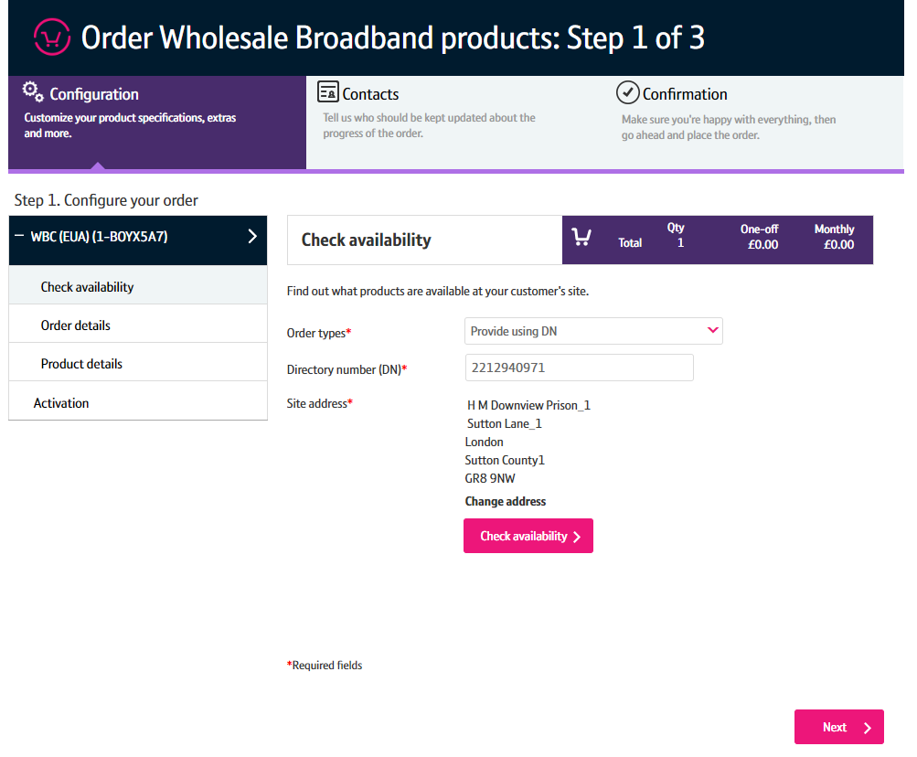
How to place a Ipstream Provide Order on Enhanced Eco+
Step 5: Check Availability
1. Click on ‘Check Availability’
1

Slide 10
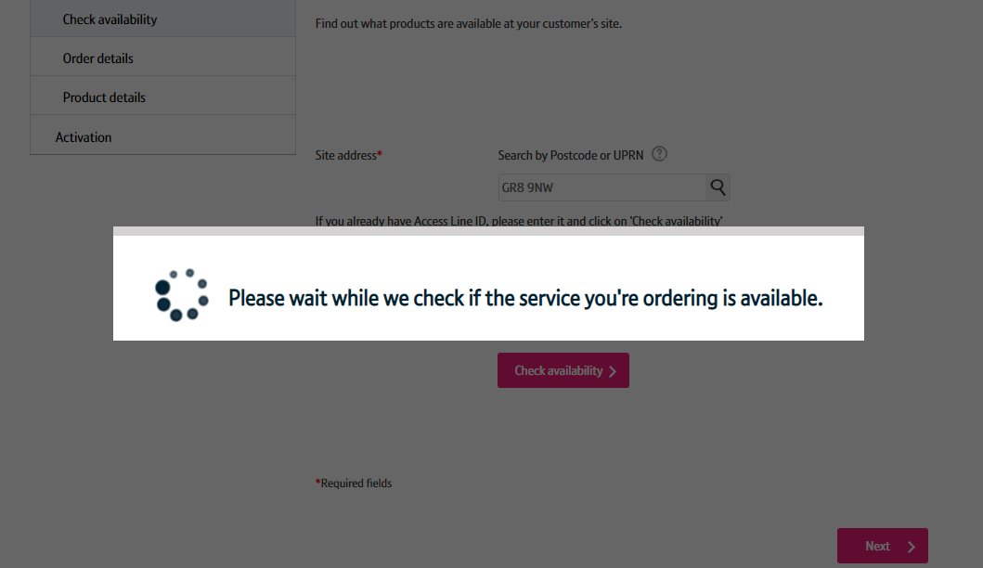
How to place a Ipstream Provide Order on Enhanced Eco+
Step 5: Check Availability
You will see this message whist the availability check is being done.

Slide 11
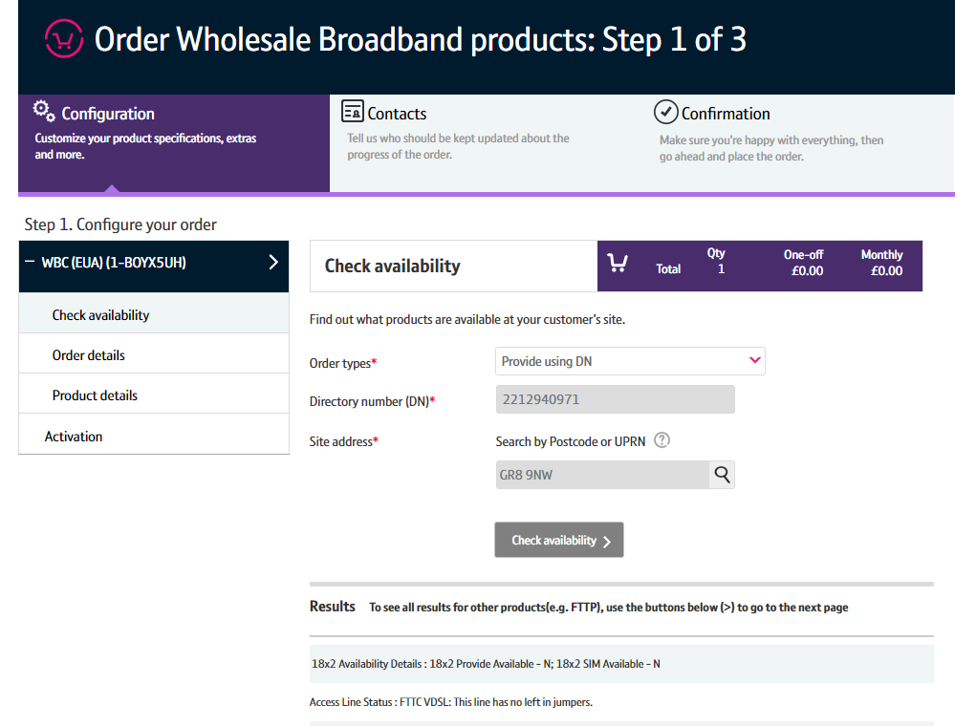
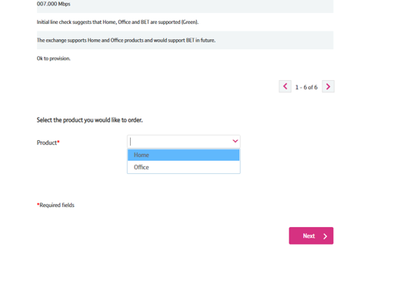
How to place a Ipstream Provide Order on Enhanced Eco+
Step 5: Check Availability
The available products will be shown in the Results table.
1. On the Product drop down select ‘Home or Office option’
2. Click ‘Next’
1

Slide 12
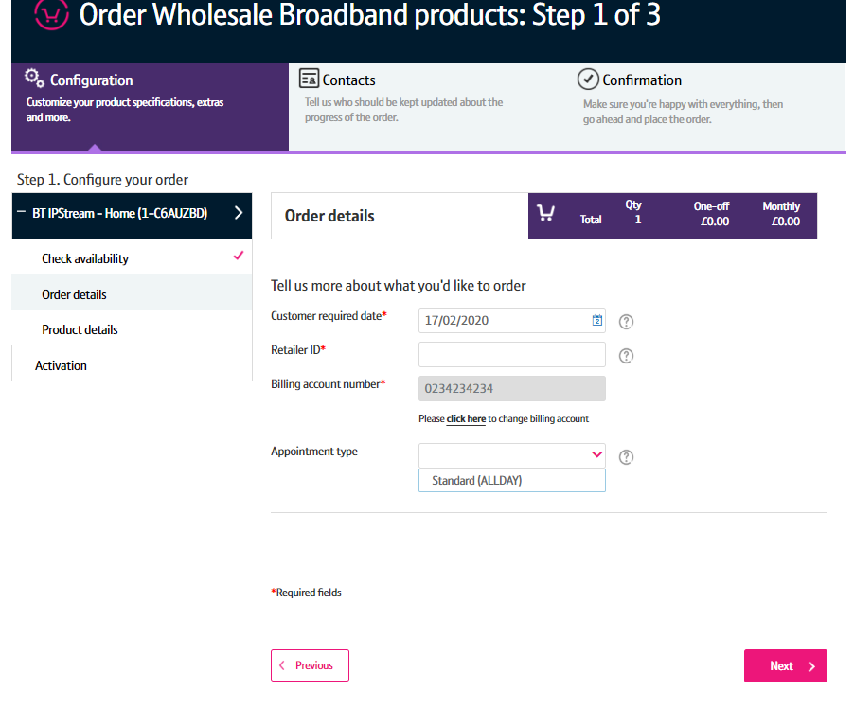

to place a Ipstream Provide Order on Enhanced Eco+
Step 6: Order Details
Customer Required by Date - will default to the standard lead time for the product and order type. If you want a date in the future, use the calendar icon to select the date you want.
Retailer ID – this is you RID ID supplied by Ofcom
Billing Account - use the click here link to select your billing account number
Appointment type – This is optional. Standard (ALLDAY) is the only option for Ipstream.
5. Click ‘Next’
1
4

Slide 13
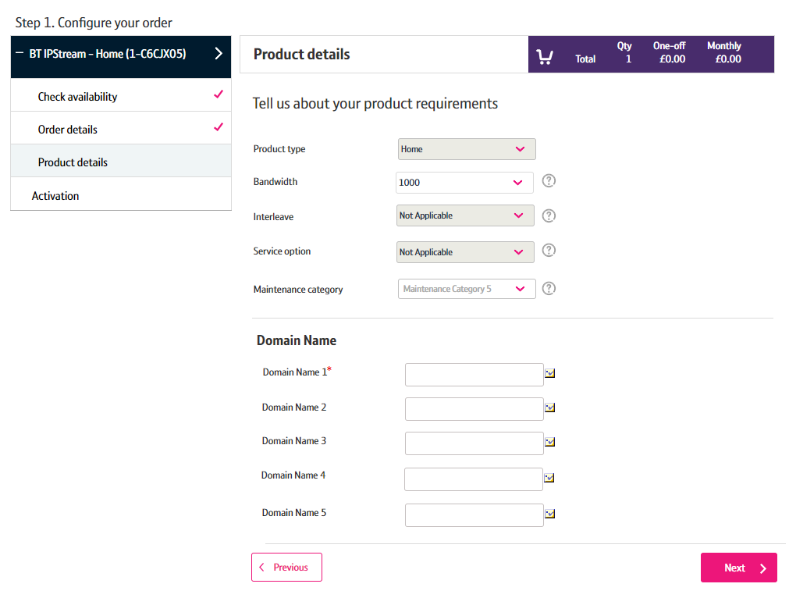
to place a Ipstream Provide Order on Enhanced Eco+
Step 7: Product Details
Bandwidth - Select the bandwidth you require.
Maintanence category – Category 5 = 40 hours repair and Category 14 = 7 hour repair.
Domain name – please select the domain names you require..
4. Click ‘Next’
1
4

Slide 14
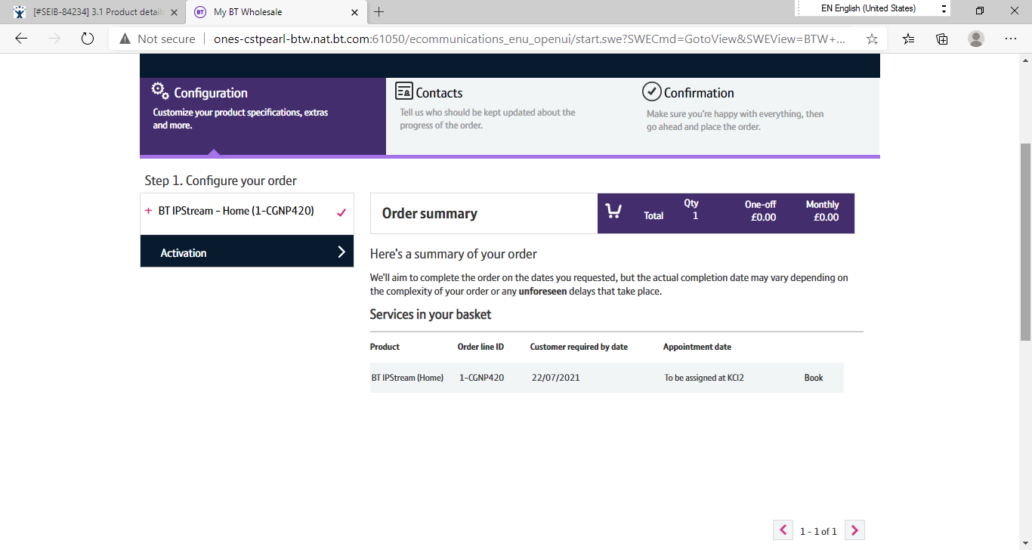

How to place a Ipstream Provide Order on Enhanced Eco+
Step 8: Order Summary
Your order is summarised confirming the selected CRD and appointment date and the costs.
If you want to change the appointment date or time you can select the Change option.
When you are happy, select ‘Next’

Slide 15
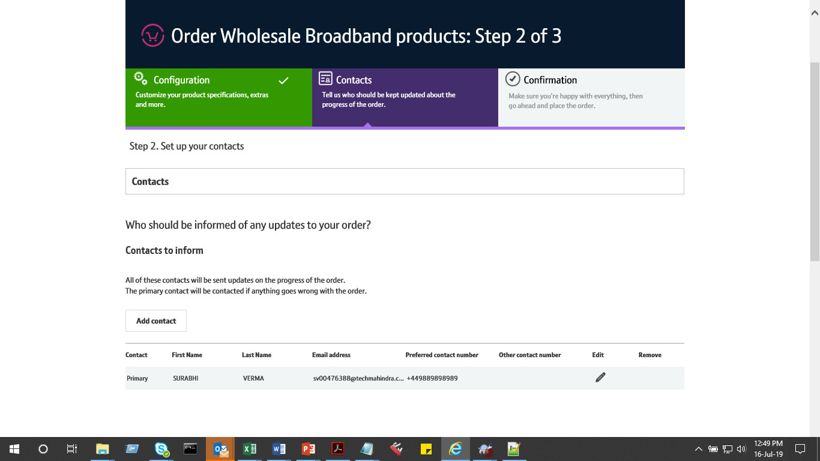
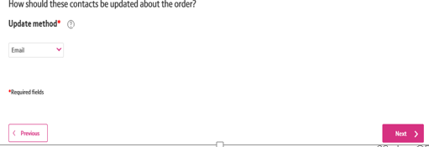
How to BTWC to place a Ipstream Provide Order on Enhanced Eco+
Step 9: Order Contacts
You can now add the details of who you want to be kept up-to-date on the progress of the order.
Your details will be automatically populated from your BTWholesale.com account details. You can edit these if needed.
You can also add any additional contacts.
You can also choose how you want to be updated; Email, Online Tracking or Critical emails only.
Click ‘Next’
1
4
4

Slide 16
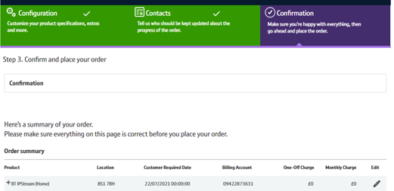
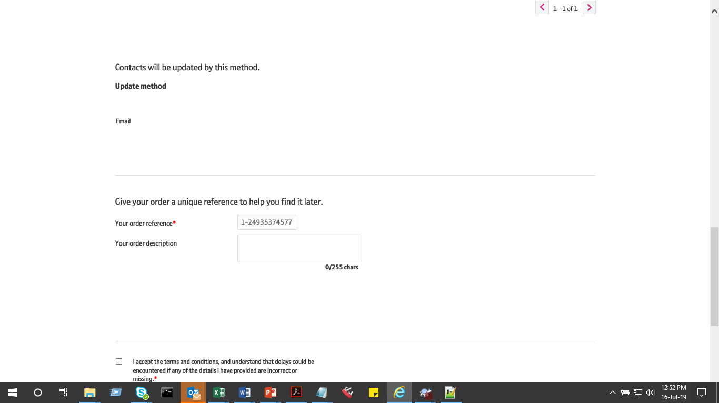

How to BTWC to place a Ipstream Provide Order on Enhanced Eco+
Step 10: Confirmation
This screen summarises your order before submission. You can use the Edit option or the Previous box at the bottom of the page if you need to make any changes.
You can now add the details of who you want to be kept up-to-date on the progress of the order.
This is your order reference.
You can also add your own order description.
You need to accept the terms and conditions with a tick in the box.
Click ‘Place Order’
1

Slide 17
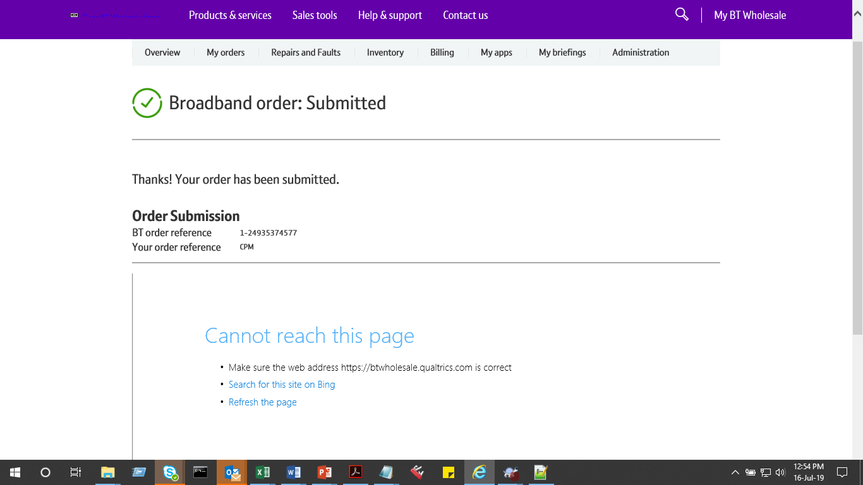
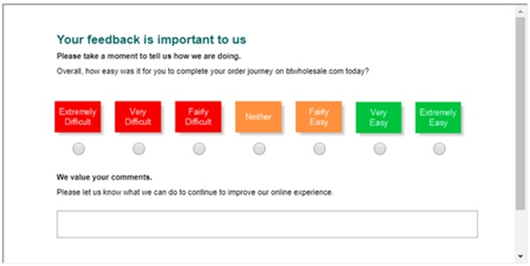
How to BTWC to place a Ipstream Provide Order on Enhanced Eco+

