Slide 1
Placing ADSL/ADSL2 + Provide order on Enhanced Eco+
Version 1
Notes:
Security classification options: – Public
– Internal
– Confidential
– Highly Confidential

Slide 2
Contents
What’s in this User Guide?
Slide 3 – Version Control
Slide 4 – Guidance
Slide 5 – New System Guidance
Slide 6 – How to Place ADSL/ADSL2+ Provide Order

Slide 3
Version Control
Date | Change | Version
December 21 | User Guide Published | 1

Slide 4
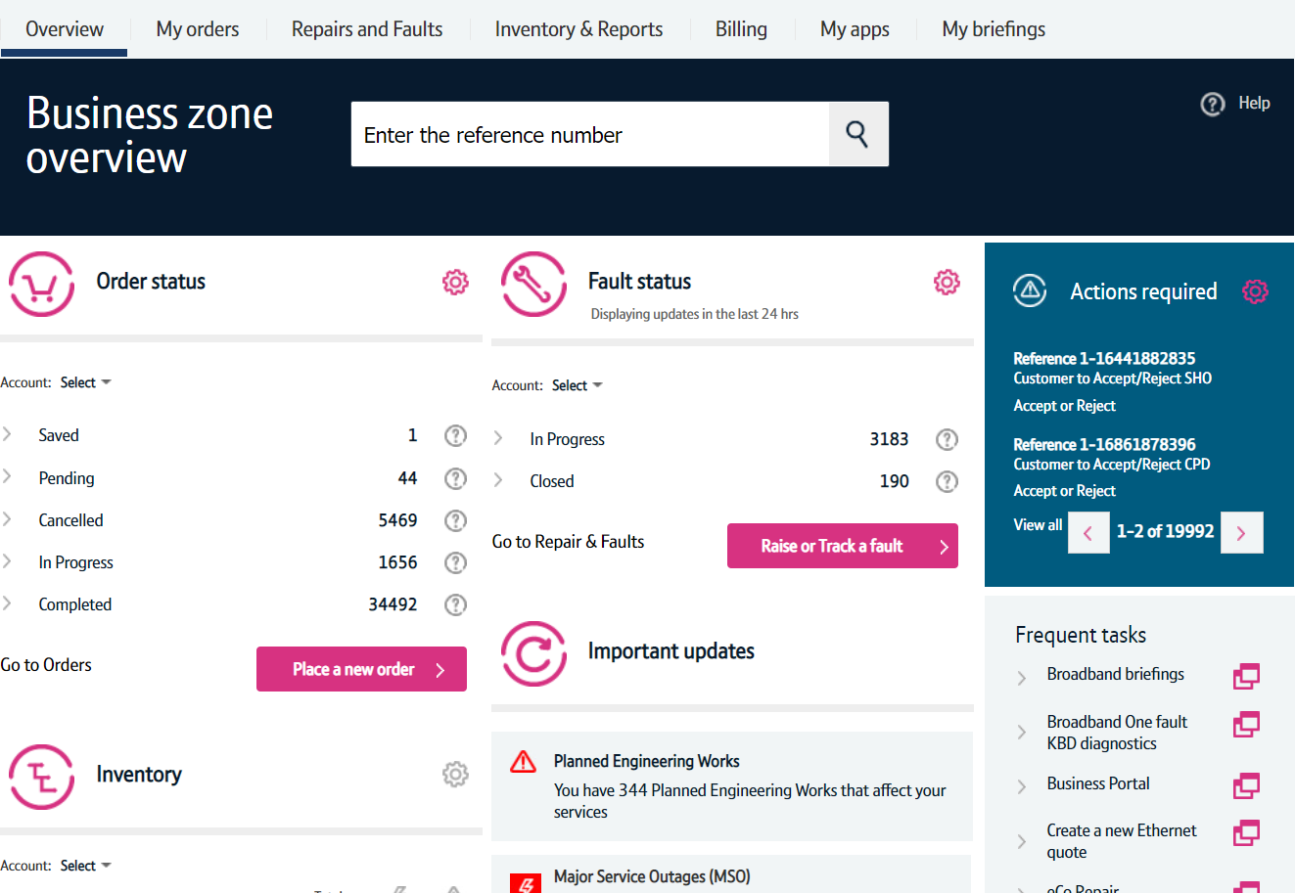
Guidance
This guide takes you through the step-by-step instructions to place a provide order on the Enhanced Eco+ system for ADSL/ADSL2+. Other order types such as SIM’s follow very similar steps with some additional parameters to complete.
Please visit our Service Provider Price List page on BTWholesale.com for a full breakdown of the costs by product.
Further information can be found in the relevant Product Handbooks

Slide 5
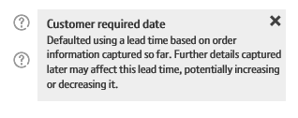
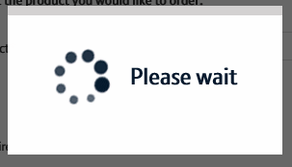
New System Guidance
We’ve designed the Enhanced Eco+ system to be intuitive and easy to use. You will notice that the information you input is largely the same but has been streamlined.
Benefits of the new system:
Quicker – the page loading time is significantly less than the previous system making it quicker to place your order. We’ve also streamlined the input needed so there are fewer clicks needed.
Helpful guidance - we’ve introduced Tool Tips against some of the order parameters. These are to help you understand what the parameter is for, the options that are available and how that will impact the service we provide. Simply click on the ? Icons.
Thinking time – when the system is progressing to the next page there is a clear symbol that tells you the page it updating. This will avoid the issues you had on Eco+ when the page was refreshing but you didn’t know that!

Slide 6
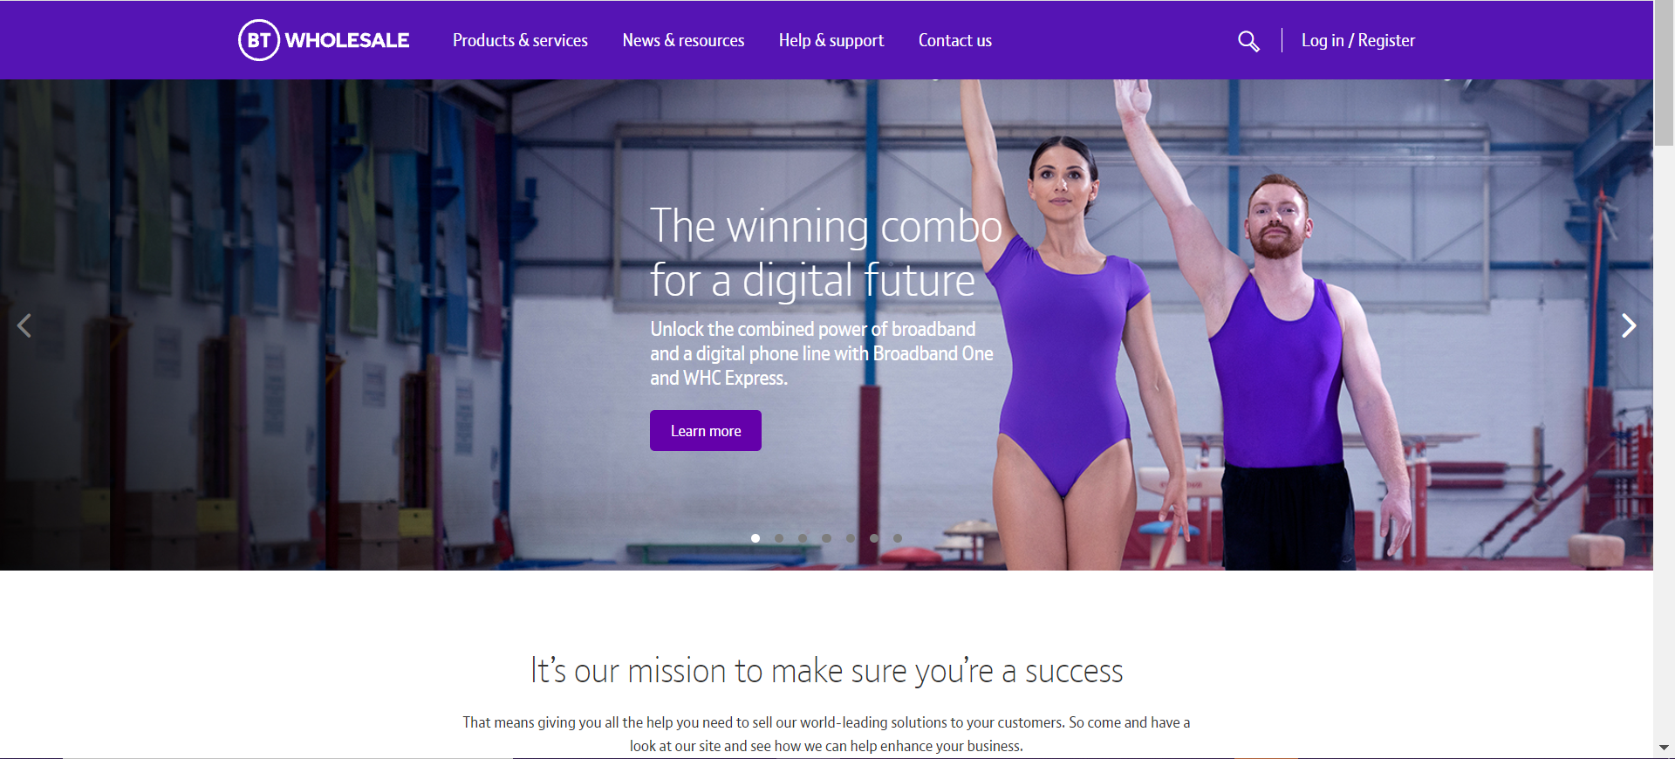
How To Place ADSL/ADSL2+ Provide Order
Step 1: Logging In
Go to www.btwholesale.com
Click on ‘Login/register’

Slide 7
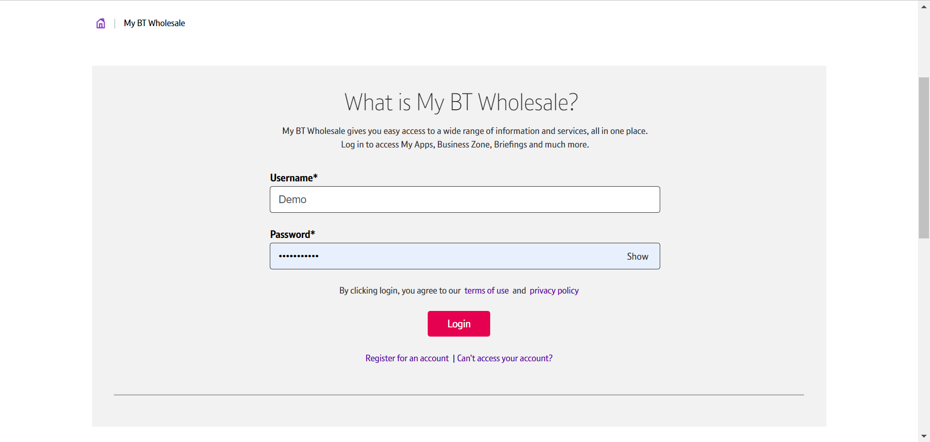
How To Place ADSL/ADSL2+ Provide Order
Step 1: Logging In
Enter your Username and Password.
Click on ‘Login’

Slide 8
How To Place ADSL/ADSL2+ Provide Order
Step 2: Accessing the journey
Once logged in, you’ll be taken to Business zone.
If you aren’t taken to Business zone, you’ll need to arrange access via your company administrator.
To access the new journey:
Click on ‘Place a New Order’

Slide 9
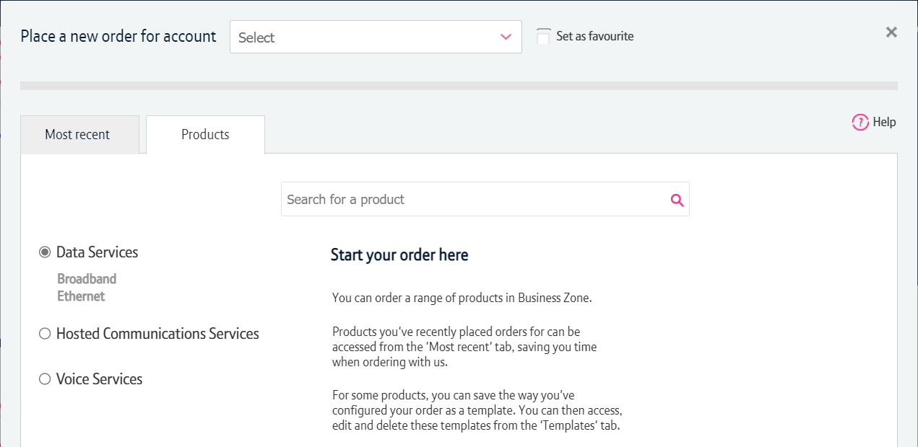
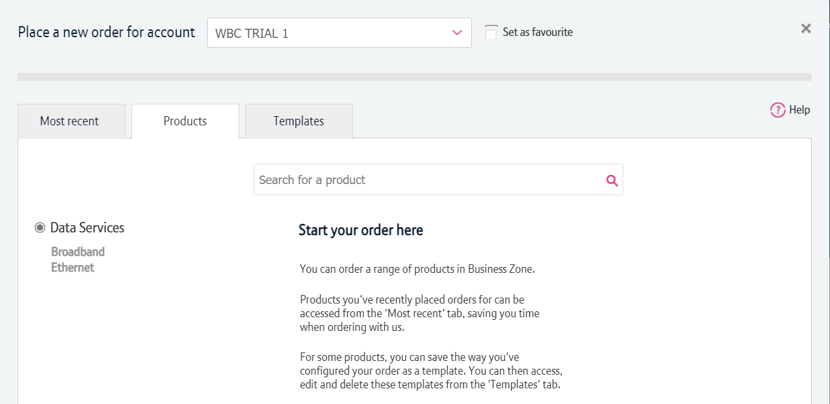
How To Place ADSL/ADSL2+ Provide Order
Step 2: Accessing the journey
If you have multiple accounts associated with your user id, you’ll need to select the applicable account from the dropdown.
If you have multiple accounts, select the account from the drop down menu. Tick the ‘Set as favourite’ box if you want this to be your default account.

Slide 10
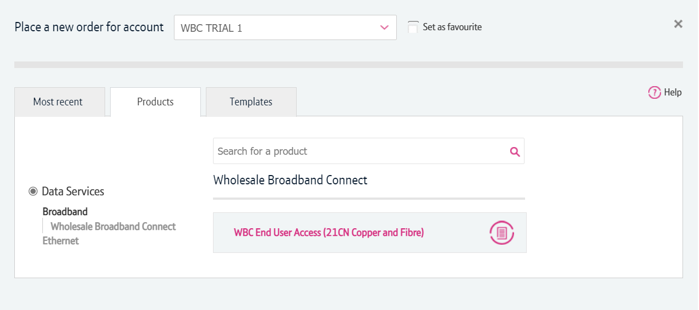
How To Place ADSL/ADSL2+ Provide Order
Step 2: Accessing the journey
Click on ‘Data Services’.
Click on ‘Broadband’.
Select ‘WBC End User Access (EUA)’.
If you have performed these steps previously then the product will be listed on the ‘Most Recent’ tab

Slide 11
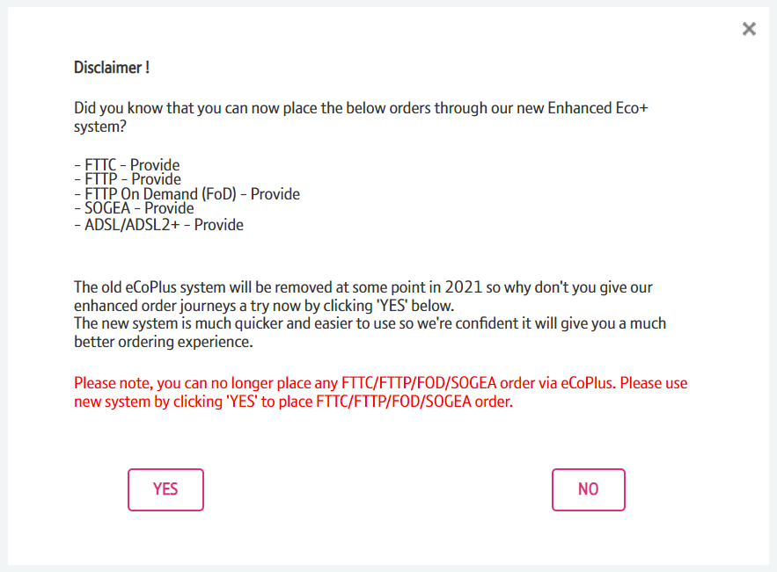
How To Place ADSL/ADSL2+ Provide Order
Step 2: Accessing the journey
You’ll see a Disclaimer message pop up. This message may be changed from time to time following releases as we add more journeys to the new system.
From here you have to click “Yes” to go to the new version of the system.

Slide 12
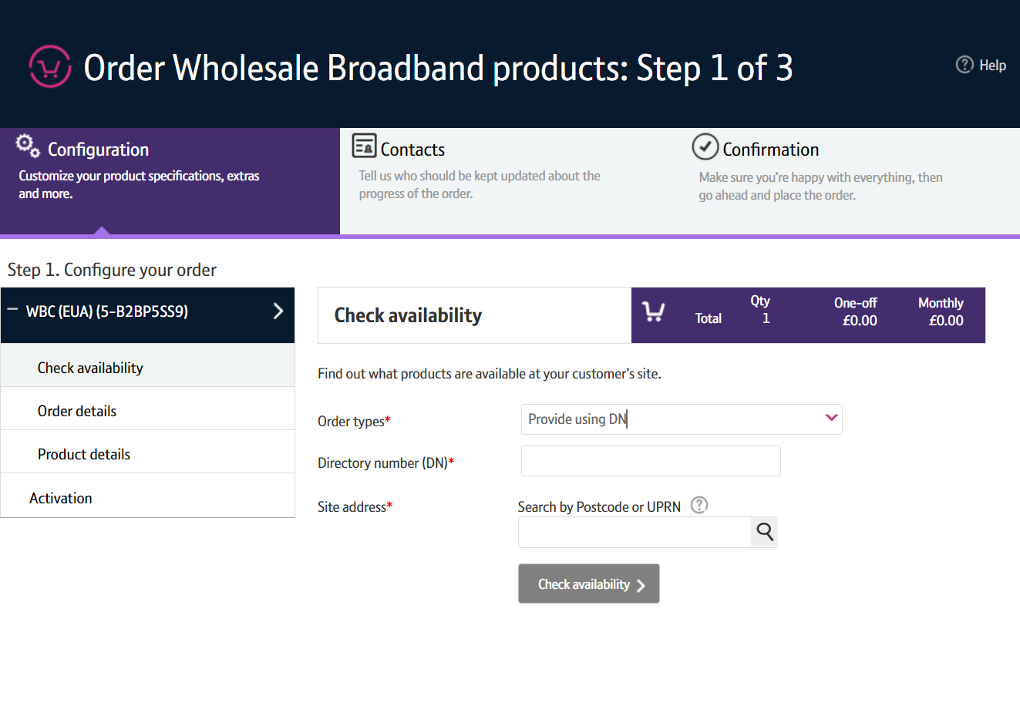
How To Place ADSL/ADSL2+ Provide Order
Step 3: Select the Order Type
Select ‘Provide using DN’

Slide 13
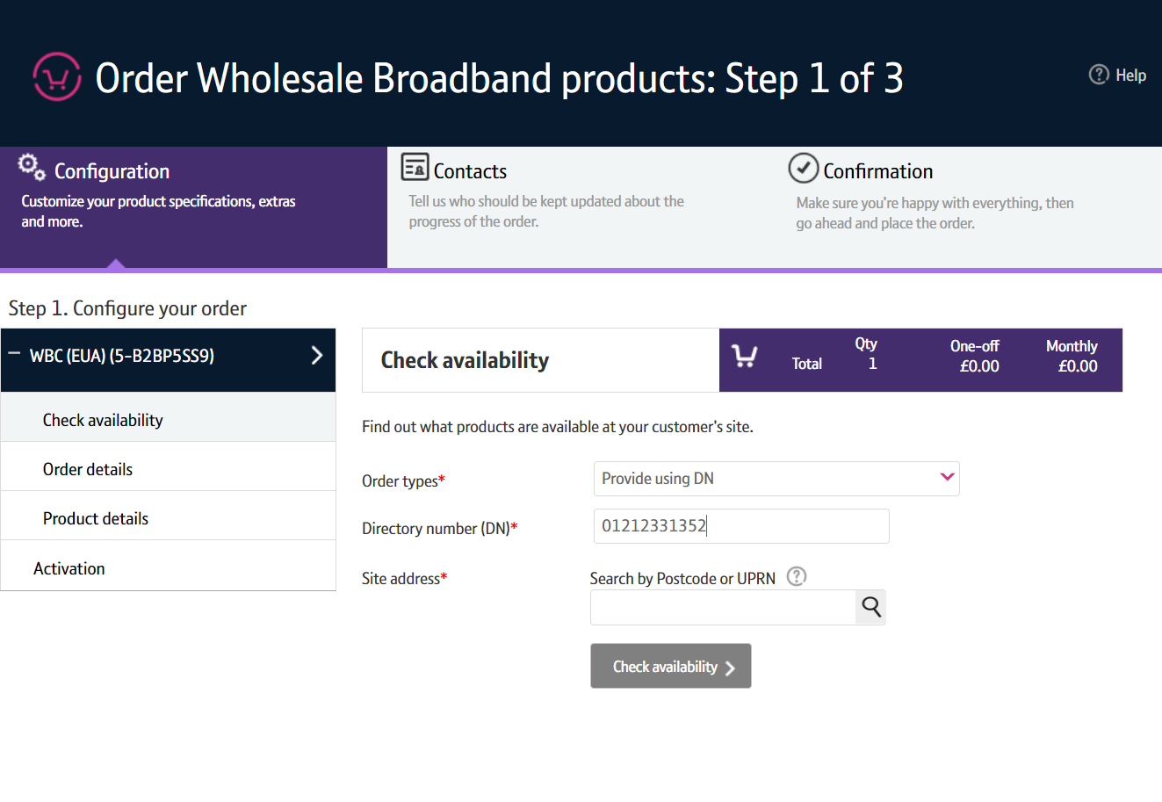
How To Place ADSL/ADSL2+ Provide Order
Step 4: Enter the Directory Number
Enter the DN

Slide 14
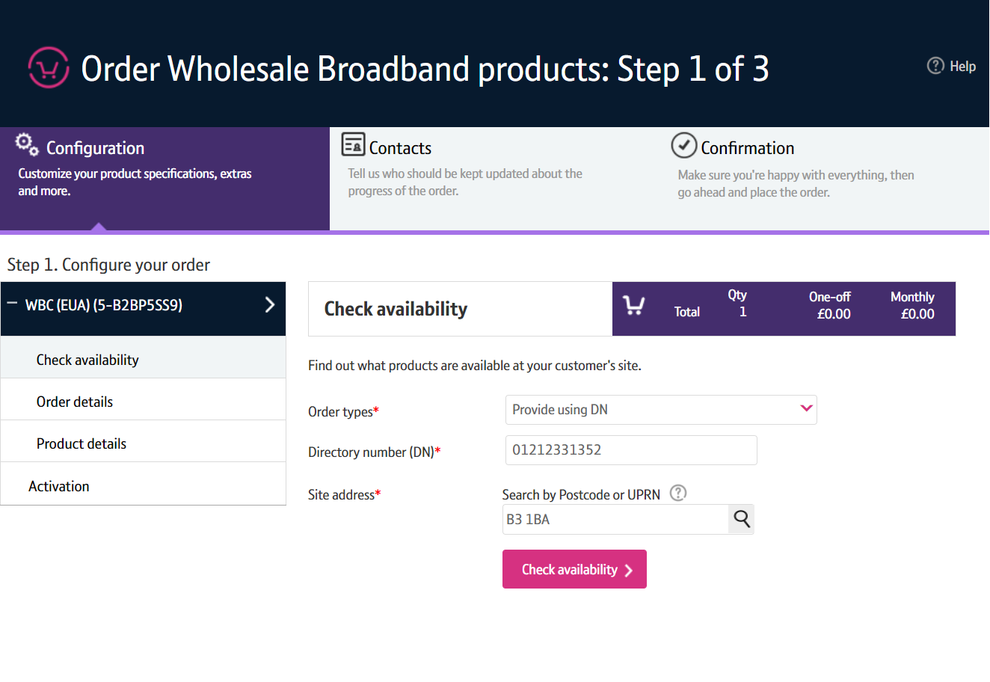
How To Place ADSL/ADSL2+ Provide Order
Step 5: Enter the Post Code
Enter the Post Code.
Press the magnifying glass to look up the Post Code.

Slide 15
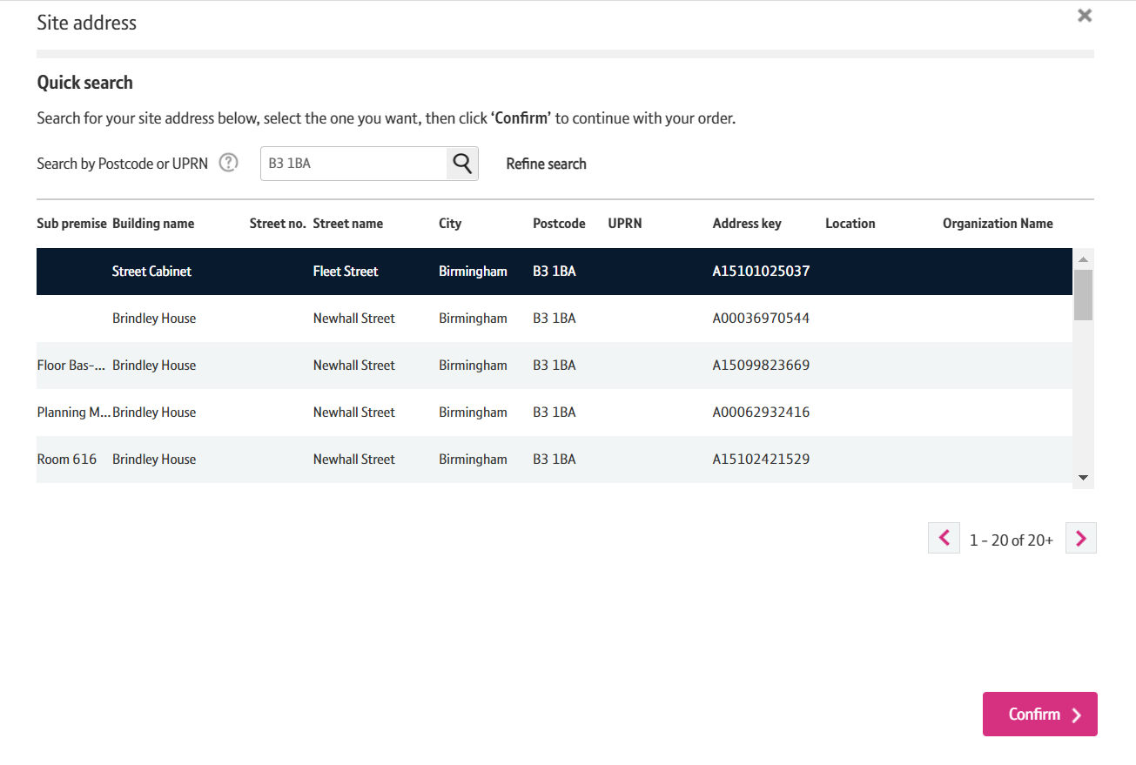
How To Place ADSL/ADSL2+ Provide Order
Step 6: Select the Address
Select the address from the list
Select ‘Confirm’ at the bottom of the page
Note: If there are more than 50 addresses for the postcode, you may need to go to the next page using the > at the bottom of the address list.

Slide 16
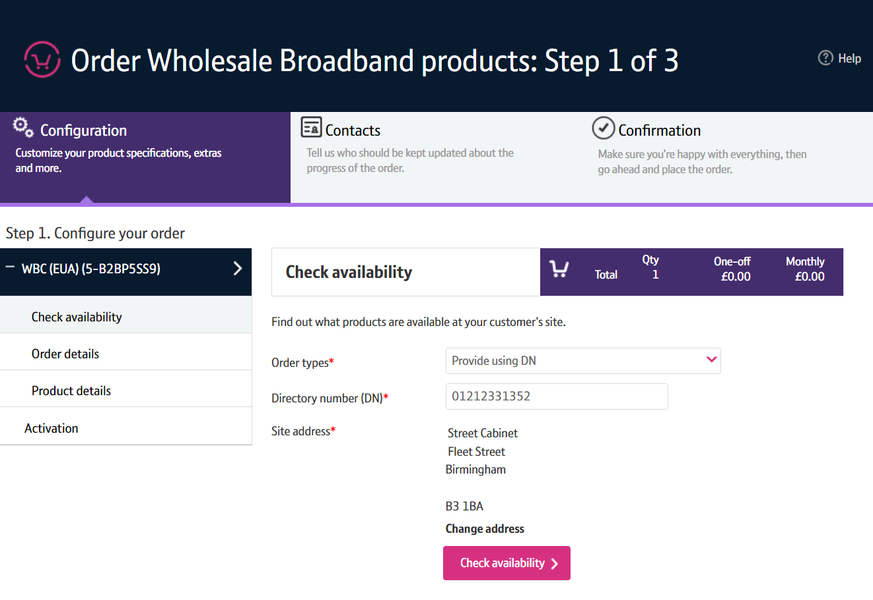
How To Place ADSL/ADSL2+ Provide Order
Step 7: Check Availability
Click ‘Check Availability’

Slide 17
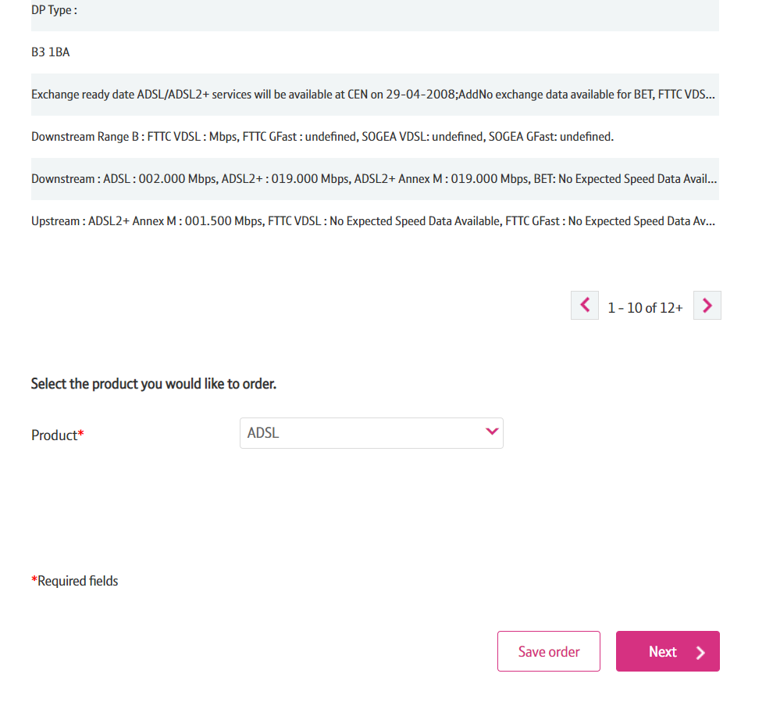
How To Place ADSL/ADSL2+ Provide Order
Step 7: Check Availability
The available products will be shown in the Results table.
On the Product drop down select either ‘ADSL’ or ‘ADSL2+’
If ADSL is chosen you can click on ‘Next’

Slide 18
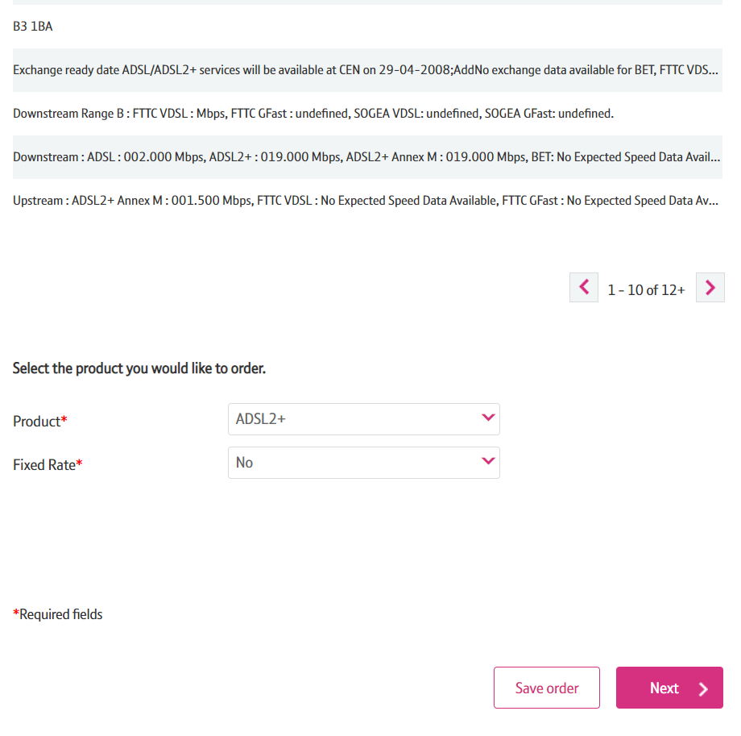
How To Place ADSL/ADSL2+ Provide Order
Step 7: Check Availability
If ADSL2+ is chosen you may be given another option.
Select either ‘Yes’ or ‘No’
Click on ‘Next’

Slide 19
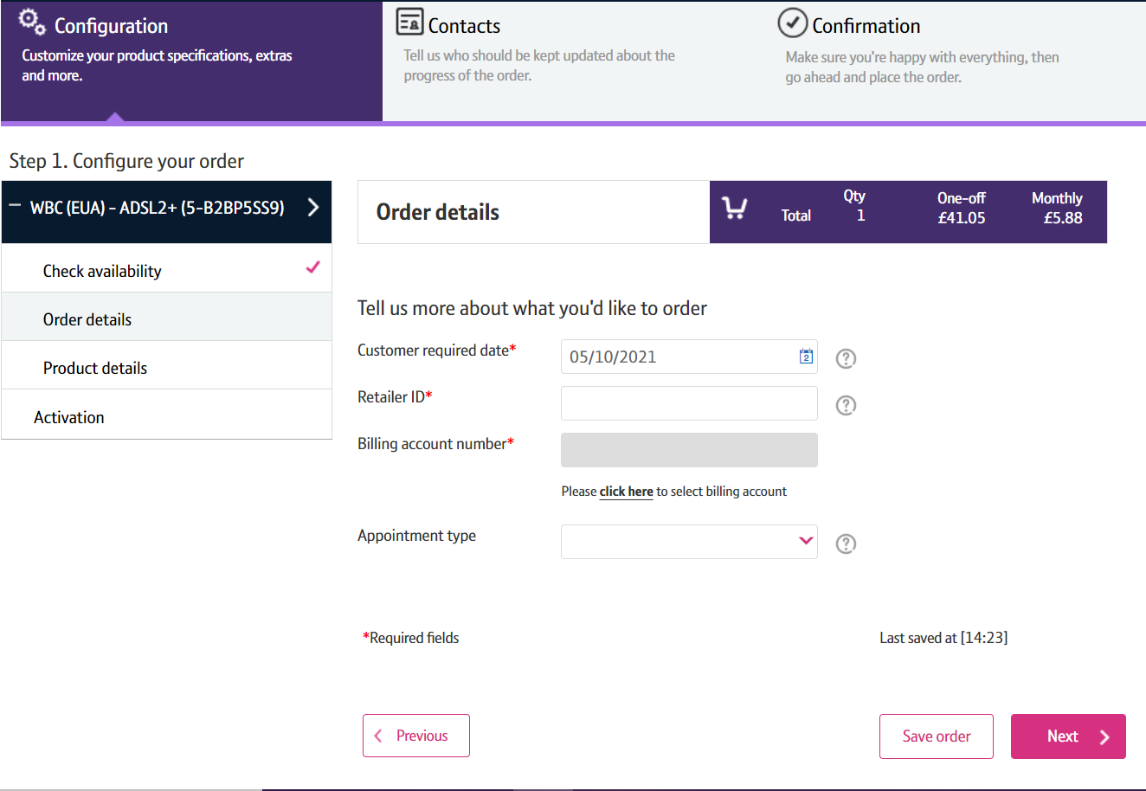
How To Place ADSL/ADSL2+ Provide Order
Step 8: Order Details
Customer Required by Date - will default to the standard lead time for the product and order type. If you want a date in the future, use the calendar icon to select the date you want.
Retailer ID – this is you RID ID supplied by Ofcom
Billing Account - use the click here link to select your billing account number
Appointment type – IMPORTANT leave blank if you require a standard All Day (non-chargeable) appointment. If you want a chargeable AM/PM or More Focused Appointment slot pick the option from the list
Click on ‘Next’

Slide 20
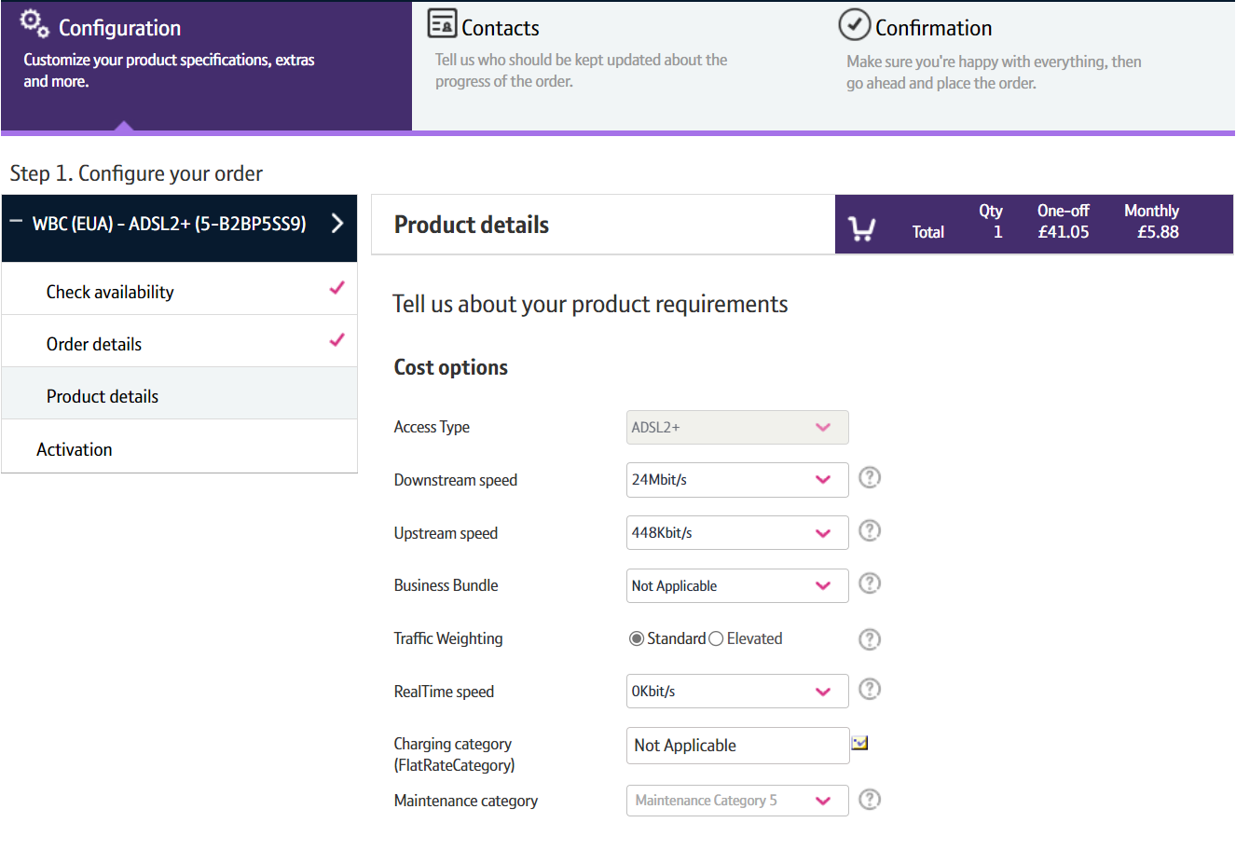
How To Place ADSL/ADSL2+ Provide Order
Step 9: Product Details
Use the tool tips at the side of each category if you need help to understand the option and what you need to select.
Downstream Speed – Select the speed you require.
Upstream Speed – Select the speed you require.
Business Bundle – refer to the product handbook for further details. Combines traffic weighting and Maintenance Category combinations.
Traffic Weighting – Options are Standard or Elevated.
RealtTime speed – Usually set to 0
Charging Category – usually Not Applicable.
Maintenance Category -: Category 5 = 40 hour repair Category 4 = 20 hour repair Category 14 = 7 hour repair.

Slide 21
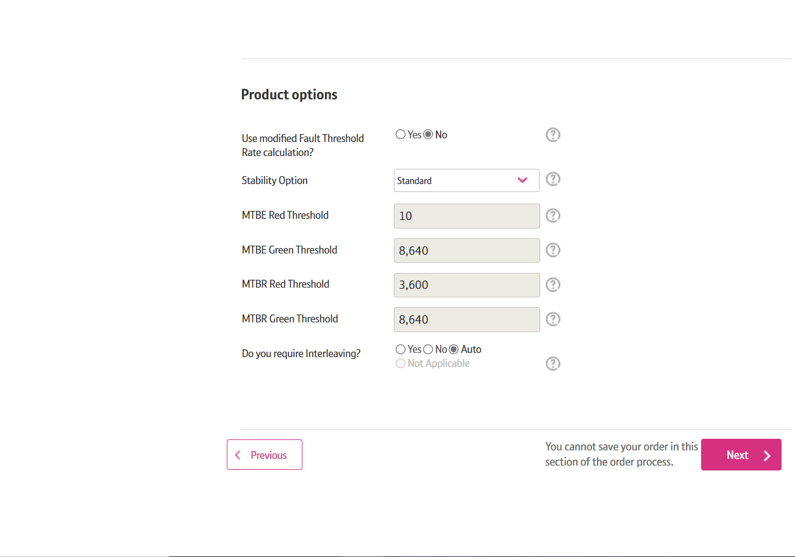
How To Place ADSL/ADSL2+ Provide Order
Step 9: Product Details
Stability Option – select Standard
Do you require Interleaving – select the interleaving option if required.
Click on ‘Next’

Slide 22
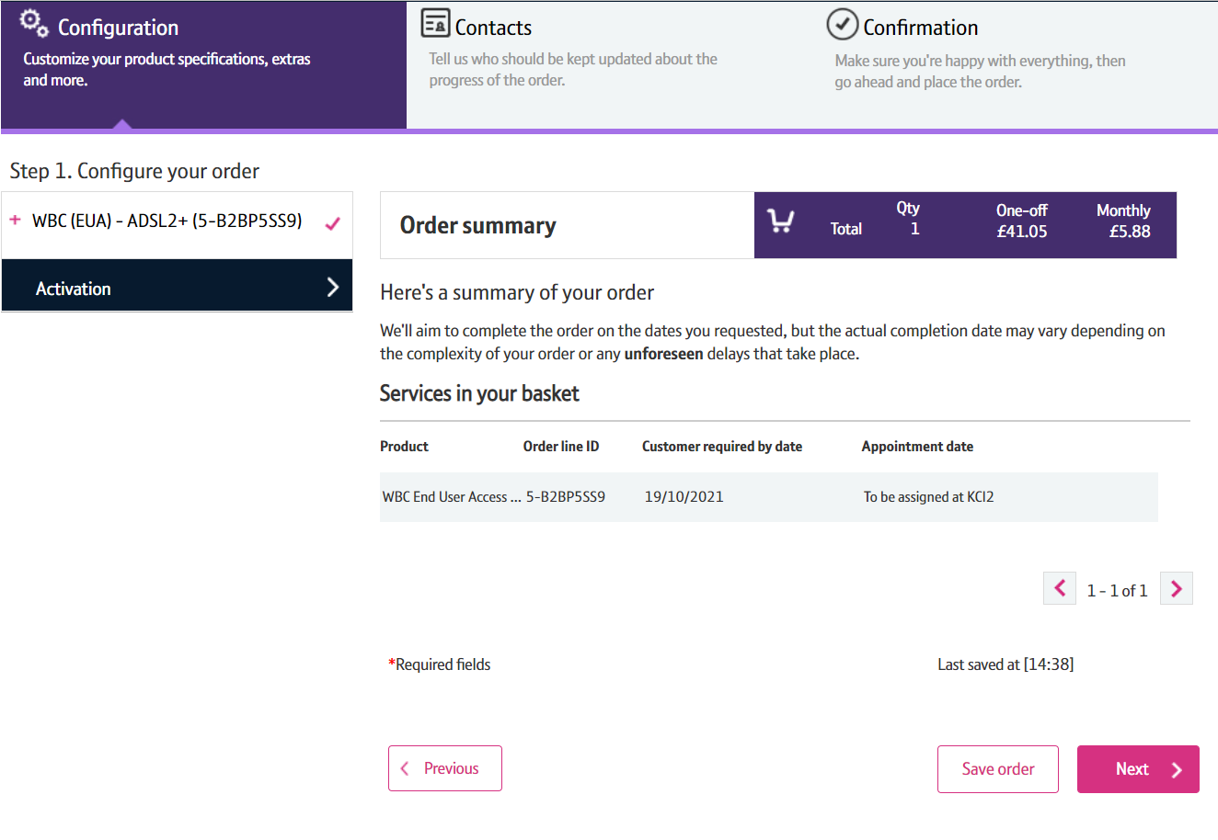
How To Place ADSL/ADSL2+ Provide Order
Step 10: Order Summary
Your order is summarised confirming the selected CRD and the costs.
When you are happy, select ‘Next’

Slide 23
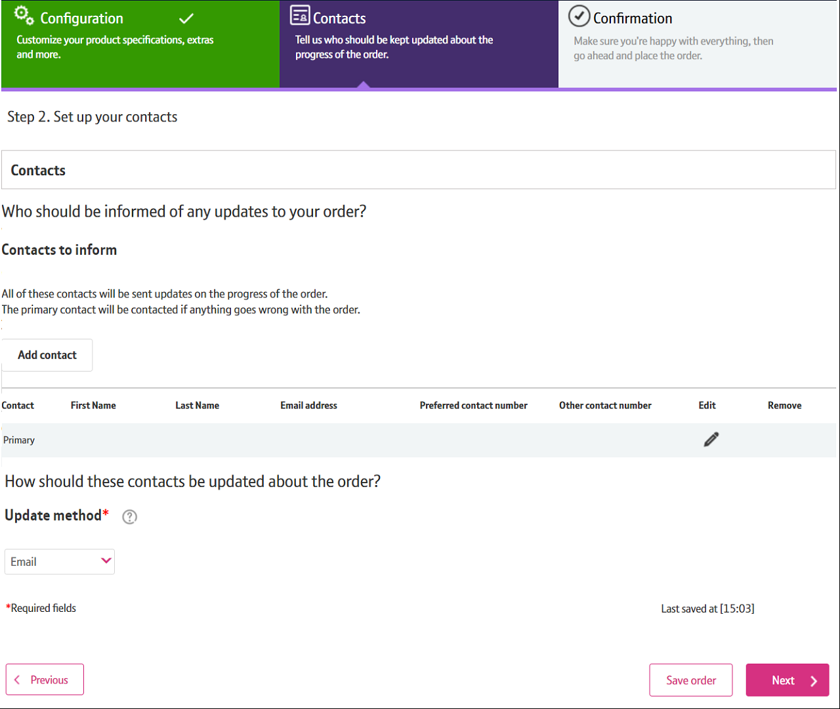
How To Place ADSL/ADSL2+ Provide Order
Step 11: Order Contacts
You can now add the details of who you want to be kept up-to-date on the progress of the order.
Your details will be automatically populated from your BTWholesale.com account details. You can edit these if needed.
You can also add any additional contacts.
You can also choose how you want to be updated; Email, Online Tracking or Critical emails only.
Click on ‘Next’

Slide 24
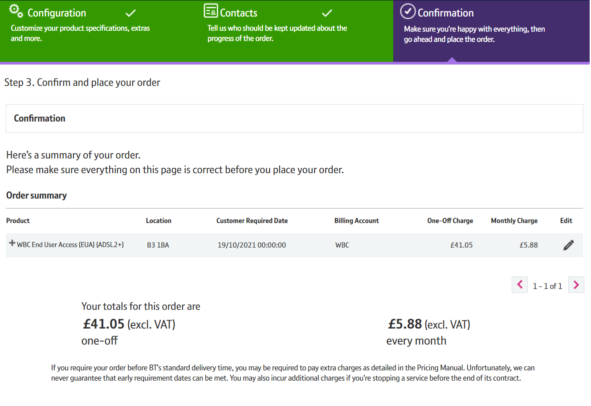
How To Place ADSL/ADSL2+ Provide Order
Step 12: Confirmation
This following summarises your order before submission. You can use the Edit option or the Previous box at the bottom of the page if you need to make any changes.
The following details are confirmed:
What product you have ordered and the options you have selected.
The monthly and one off costs
24

Slide 25
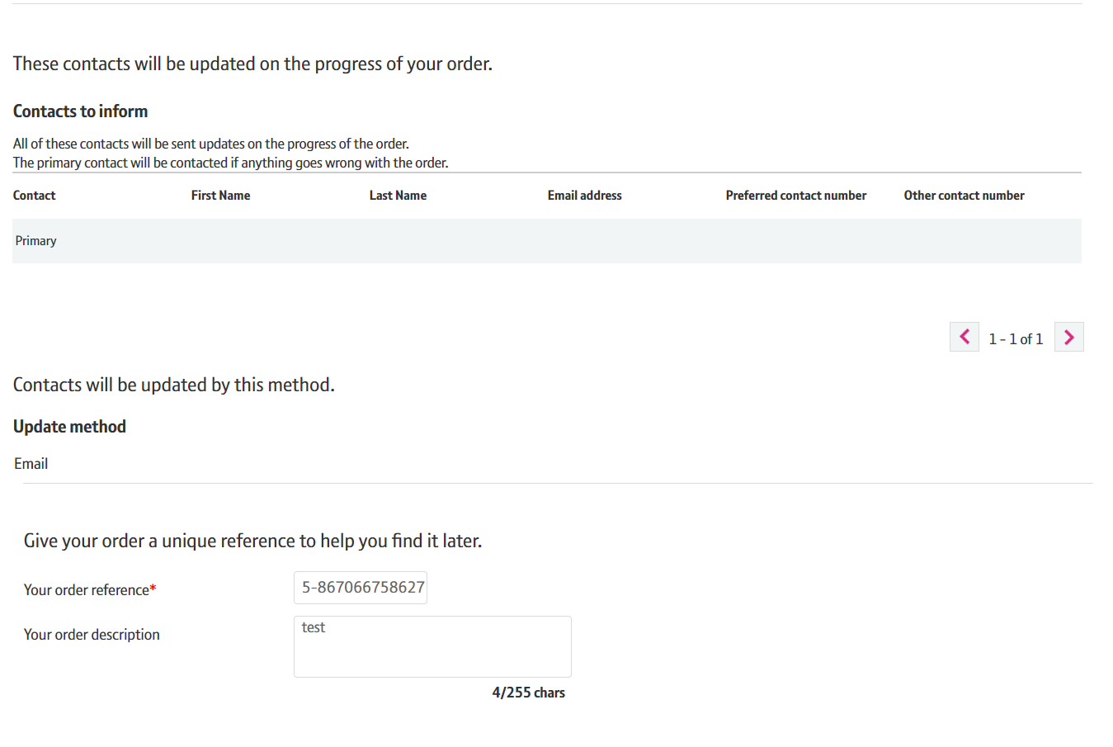
How To Place ADSL/ADSL2+ Provide Order
Step 12: Confirmation
Who needs to be kept updated on the progress of the order and how.
You can also add your own order reference and description
25

Slide 26
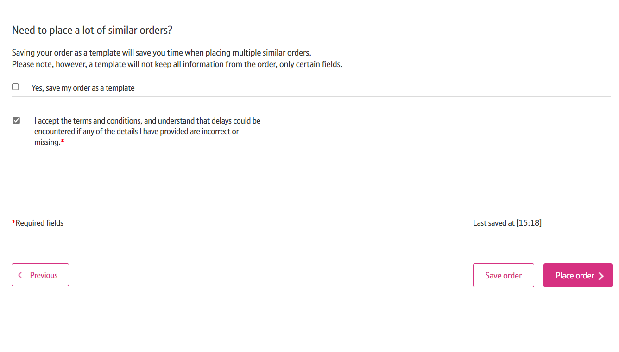
How To Place ADSL/ADSL2+ Provide Order
Step 12: Confirmation
Select the tick box to accept the Terms and Conditions.
Select ‘Place order’
26

Slide 27
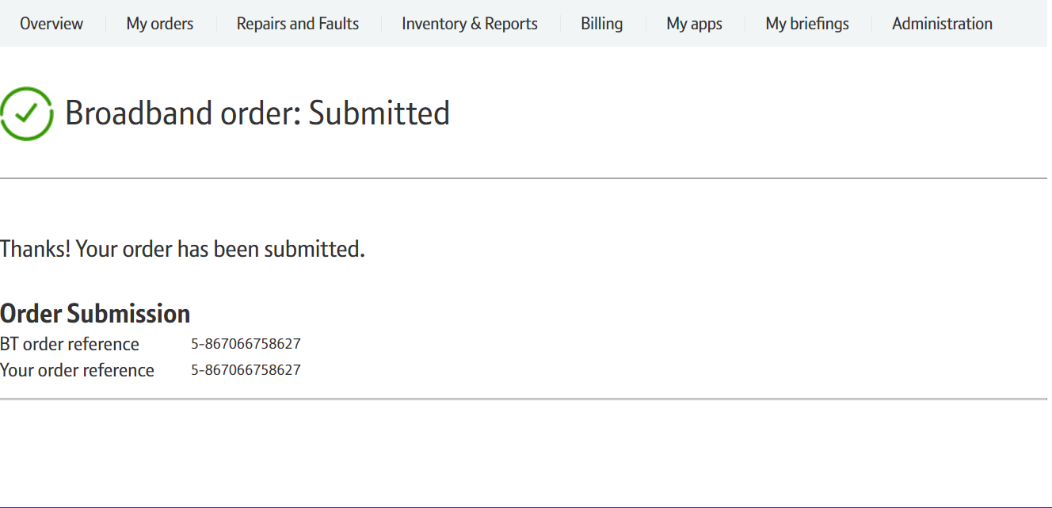
How To Place ADSL/ADSL2+ Provide Order
Step 12: Confirmation
Final confirmation that your order has been submitted successfully and what your BT Wholesale order reference is.
Please fill in the survey (if offered) to tell us how easy it was to submit your order. We’re always looking to improve the systems so your feedback is really valuable to us.
27

