Slide 1


LTE
Title subheading in here
IPEX Customer Briefing Info
March 2017

Slide 2
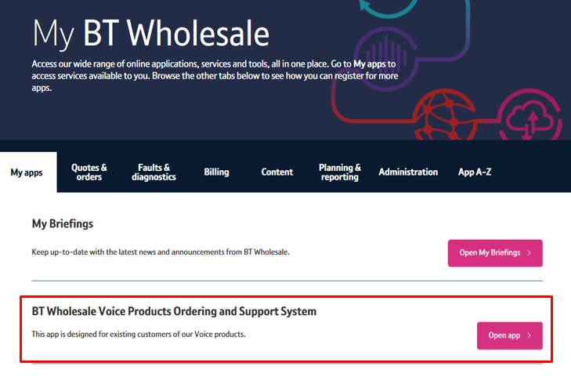
This pack explains to customers the upcoming changes to the IPEX fault reporting journey.
A new APP called the
“BT Wholesale Voice Products Ordering and Support System”
has been developed
BTWholesale & Ventures March 2017

Slide 3
What is happening?
The introduction of an online IPEX fault reporting journey.
Where is it happening?
The IPEX fault APP is reached via the www.BTWholesale.com web portal
Why is it happening?
The online APP provides a better customer experience.
This aligns the IPEX customer experience with other products and services.
Customers can receive updates online.
Customers can report faults and track faults online.
Customers can continue to use their existing fault reporting template
BTWholesale & Ventures March 2017

Slide 4
Who is it happening to
All IPEX customers are being asked to move over to the APP
When is it happening?
Starting in April 2017 Customers will be asked to move from their current Email fault reporting process over to the IPEX APP.
The current email fault reporting process will cease from the 30th June 2017
How is it happening?
Customers will be briefed regarding the closure of their email journey
Customers will be responsible for ensuring they have access to both:
www.btwholesale.com
How does this impact me?
“BT Wholesale Voice Products” APP
Customers will continue to use the existing fault reporting template, but instead of emailing this to BT it will be attached to a trouble ticket raised via the APP
BTWholesale & Ventures March 2017

Slide 5
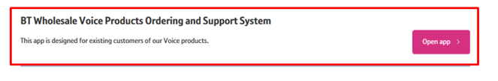
What do I need to do?
Does the customer have access to BTWholesale.com?
Customers can request BTWholesale.com access using this URL - https://www.btwholesale.com/registration/registrationHome.do
No
Yes
Does your company have a My Admin user account on the BTW Portal?
My Admin - https://www.btwholesale.com/pages/sc/downloads/my_admin/MyAdmin_application_form.doc
Unsure
No
Contact your account manager
Yes
Request access to the BT Wholesale Voice Ordering and Support system APP on www.btwholesale.com Under the “My APPS” then “APP A-Z”
Does the customer have access to the “BT Wholesale Voice Ordering and Support system” ?
No
BTWholesale & Ventures March 2017

