Slide 1

Getting access to Business Zone – User Guide
BT Wholesale Online
V2
LEGAL NOTICE: The information contained in this briefing is confidential information as per your terms and conditions with BT. Please do not forward, republish or permit unauthorised access. The content is accurate at the time of writing and is subject to change.

Slide 2
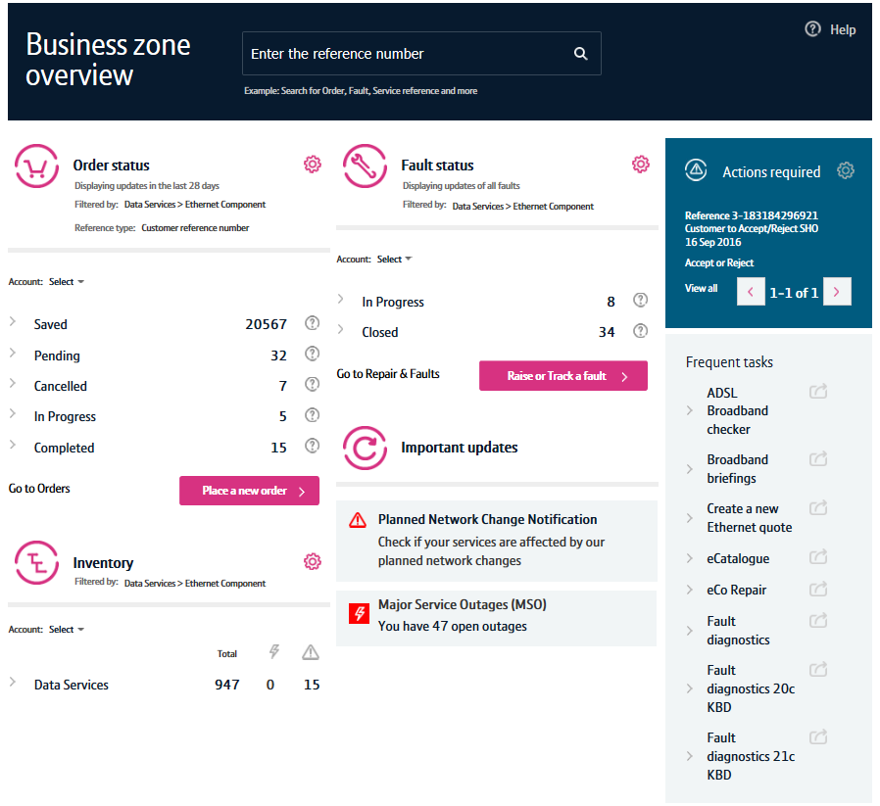
Contents
What’s in this User Guide?
p4 - Introduction
p5 – Accessing Business Zone
p6 – How do I find my company administrator?
p7 - How to grant someone access to Business Zone

Slide 3
Version Control
Date | Change | Version
16/01/16 | User Guide Published | 1
30/04/18 | Re-branded | 2

Slide 4
Introduction
What is Business Zone?
Business Zone is our one-stop shop for you to do business with us online.
Accessed via btwholesale.com, Business Zone gives you a consolidated view of all your BT Wholesale orders, faults and inventory. And our improved search facility and filters make it easy to find the information you’re looking for.
In addition, you can see all your services that are affected by Major Service Outages (MSOs) and Planned Network Change Notifications (PNCNs) from Business Zone.

Slide 5
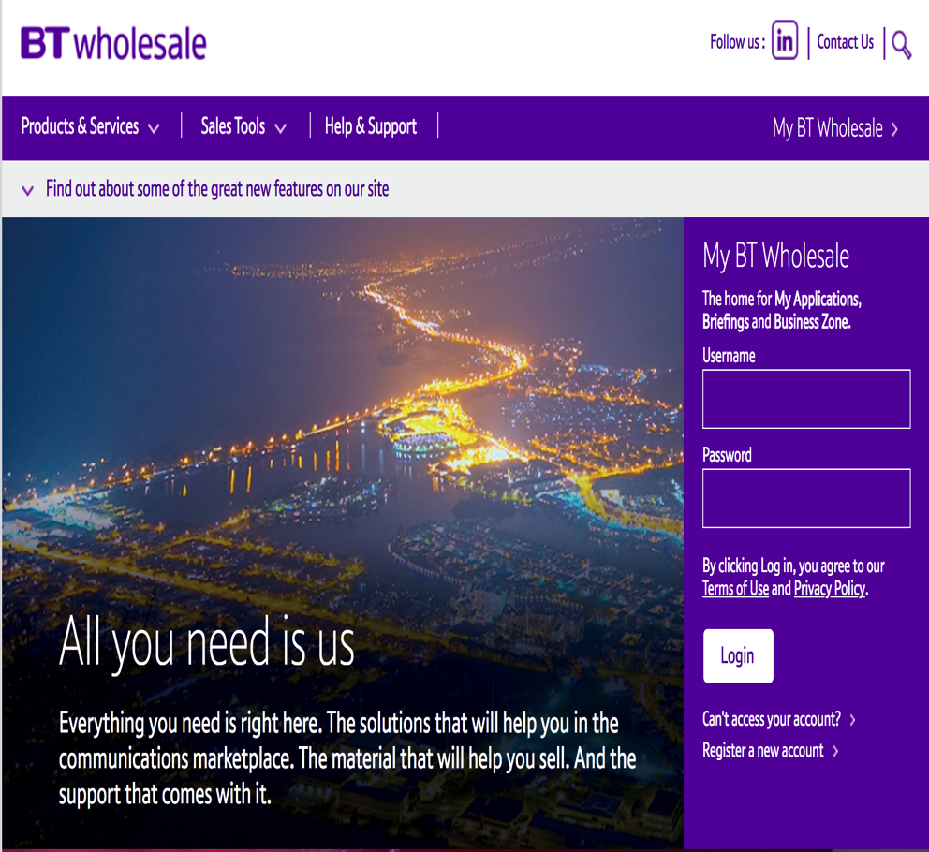
Accessing Business Zone
Accessing Business Zone is easy. Simply login to btwholesale.com. If you have the correct privileges and accesses, you’ll be taken directly to My BT Wholesale.
If you aren’t taken to Business Zone on login, you’ll need to contact your company administrator to provide you access.

Slide 6
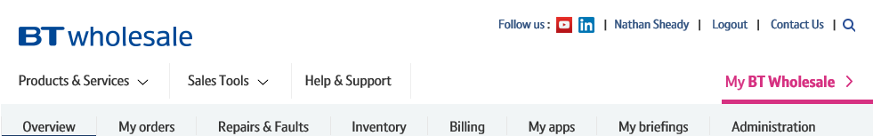
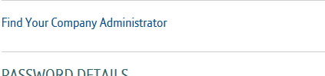
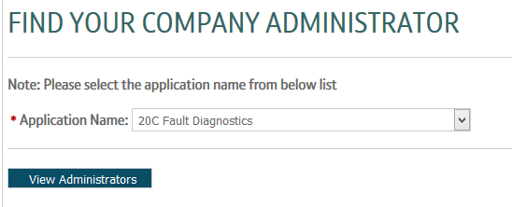
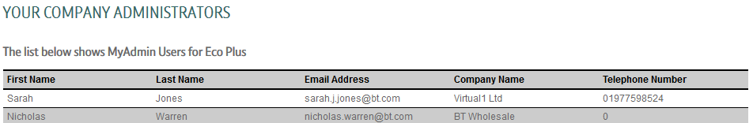
How do I find my company administrator?
Your company administrator can provide you access to our applications. To find out who they are:
Click on your name located to the top-right of the btwholesale.com dashboard screen
Click ‘Find Your Company Administrator’
Select an option from the dropdown and click ‘View Administrators
A list of contacts who can grant you access to the application will now be displayed
If you want to become a company administrator, download and complete this form, then send it to us.
1
2
3
4

Slide 7
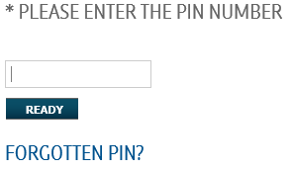
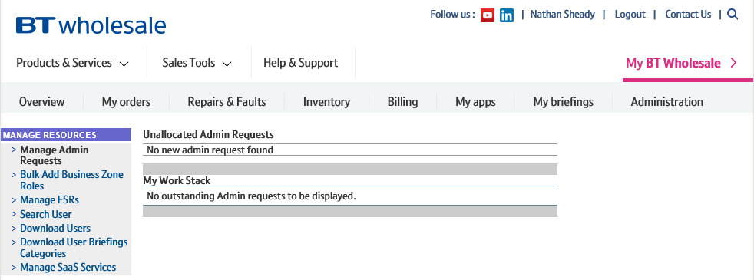
How to grant someone access to Business Zone
If you are a company administrator, you can provide people in your organisation access to Business Zone.
To do this, first you need to log into the Administration area of btwholesale.com:
On Business Zone, click ‘Administration
Enter your pin number and click ‘Ready’
You’ll now be logged into the Admin area
1
2
3

Slide 8
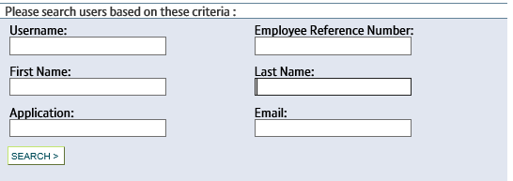
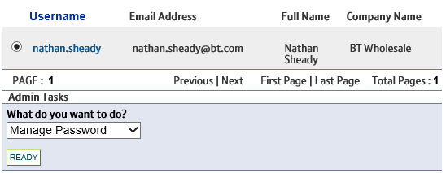
How to grant someone access to Business Zone
You now need to search for the user you wish to grant access to Business Zone:
To do this, first you need to log into the Administration area of btwholesale.com:
Click ‘Search User’
Enter the user’s details in the search fields and click ‘Search’
The user’s details will now be displayed
1
2
3

Slide 9
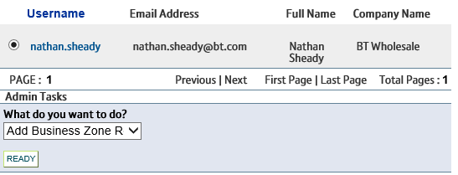
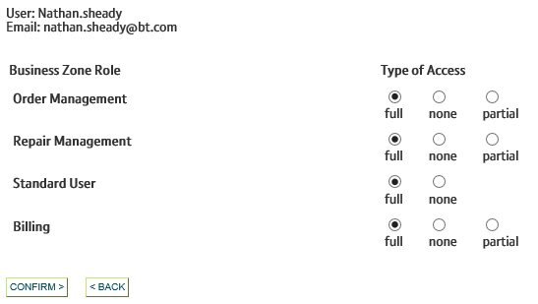
How to grant someone access to Business Zone
You now need to apply Business Zone roles to the user:
Select the user you wish to grant access to Business Zone from the list and select ‘Add Business Zone Roles’ from the dropdown. Now click ‘Ready’.
Select the type of access you want to grant the user from the list and click ‘Confirm’.
The user will now have access to Business Zone.
They’ll need to log out of any existing sessions and log back in for the changes to take place.
1
`````````
`
2

